Slide 1
ANTI-RIOT DRONE WITH AUTONOMOUS PATH
​

Slide 2
Team members
D.VISHAAL
S.SRINATH
N.ANIRUDDHAN
21BRS1173
21BRS1224
21BRS1682

Slide 3
PROBLEM STATEMENT
Riots and civil unrest present persistent challenges to law enforcement agencies globally, demanding innovative technological solutions to maintain public order and ensure the safety of both citizens and law enforcement personnel. As traditional methods often fall short in effectively managing such complex situations, the need for advanced tools, particularly in the form of anti-riot drones with autonomous capabilities, has become increasingly evident. These drones have the potential to revolutionize crowd control, surveillance, and situational awareness, offering a proactive and efficient approach to handling volatile scenarios.

Slide 4
OBJECTIVES
The objective of this project is to design, develop, and implement an anti-riot drone equipped with autonomous features to enhance its effectiveness in handling crowd control situations. The drone should be capable of performing various tasks autonomously, such as monitoring and assessing the situation, dispersing non-lethal deterrents, and providing real-time data to the command center. The drone platform is based on a quadcopter model with a flight controller, a GPS, and a transmitter and receiver. The crowd detection module uses a machine lerning model to identify and estimate the density and distribution of the people in the scene. The delivery module uses a PID controller to optimize the flight path and speed of the drone and a dispenser to release the chocolates at the desired location.

Slide 5
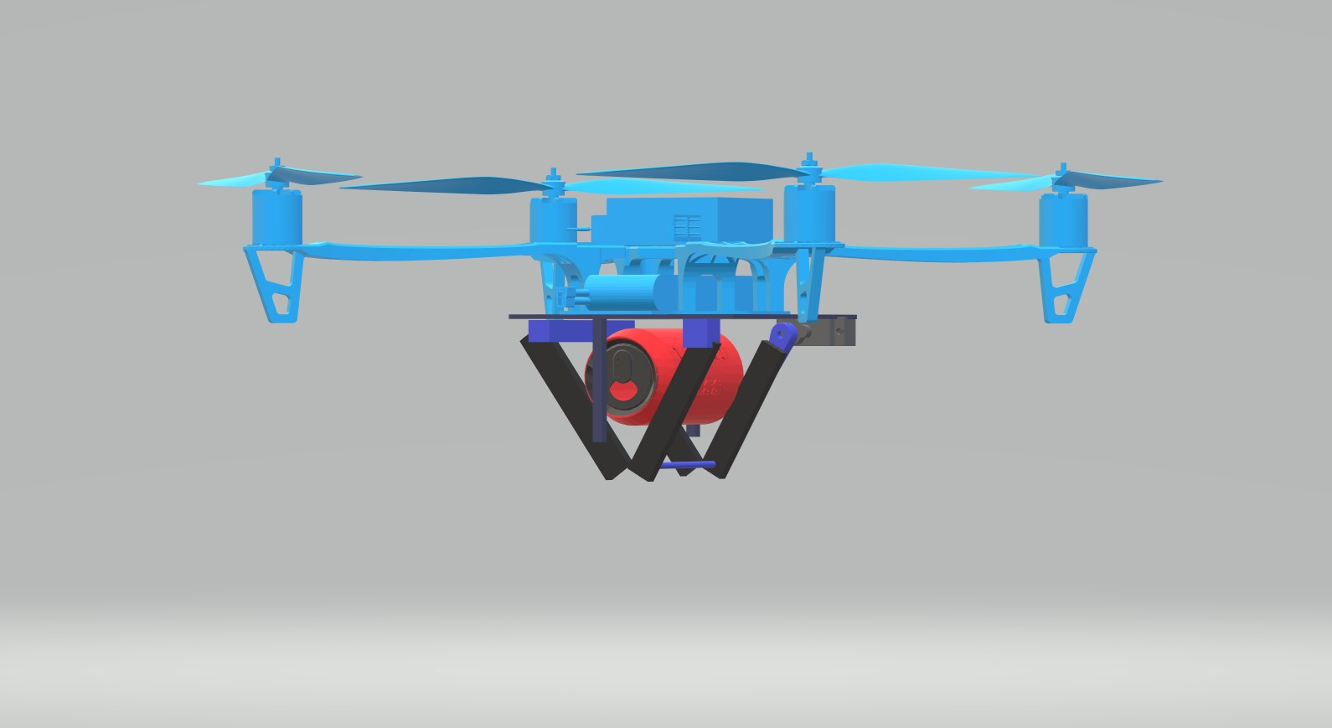
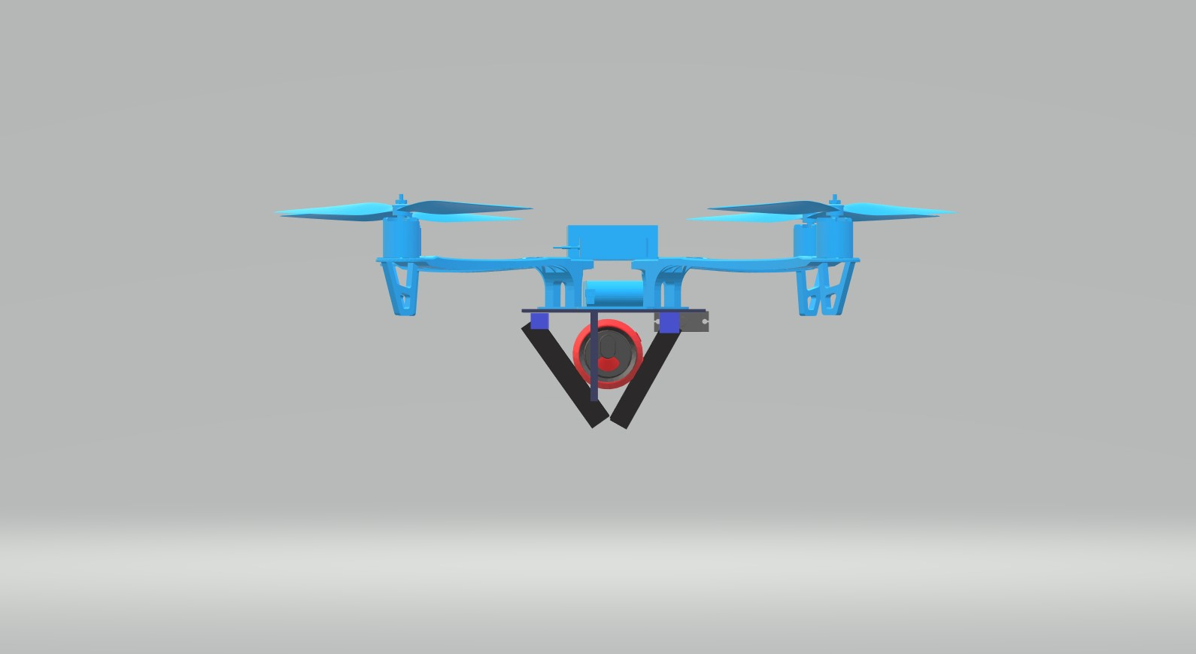
EXPECTED OUTCOME
Upon successful completion of this project, the expected outcome is a fully functional anti-riot drone prototype that surpasses current technological standards. The drone should demonstrate its capabilities through rigorous testing and validation processes, yielding comprehensive documentation on its design, algorithms, and software architecture. The deployment of this drone in real-world simulations should showcase its efficacy in enhancing law enforcement capabilities, providing valuable insights for strategic decision-making, and ultimately contributing to the preservation of public safety during civil unrest. The user manuals and training materials accompanying the drone should empower law enforcement personnel to effectively and ethically operate the system while adhering to legal and human rights standards.

Slide 6
Thank you

